Slide 1
Portal For Farmers To Sell The Products For Better Rate
Guided By : Mr.V . VinayKumar
TEAM : -
1608-18-733-010 - M. Deepak
1608-18-733-019 - M. Vamsi
1608-18-733-047 - A. Bhanu Prasad

Slide 2
Abstract : -
E-Farming is a PHP & MySQL-based website which gives an idea to the farmers how to use e-farming to sell their products. Farmers will get all the new ideas to improve their productivity and they can buy and sell their products online.

Slide 3
Introduction : -
E-Farming is a website developed for farmers. This website gives suppose to the village farmers who want to use this facility and learn how is it possible and how they can use e-farming to sell their products. If the farmers have knowledge of computer then they can directly register in the site and sell their product. They can know how they can open this site and register with it and sell their products online etc. E-Farming is a project developed to build a website which will help farmers from to sell their products to different cities through online. Farmers can use this facility and can learn how is it possible and how they can use e-farming to sell their products.

Slide 4
Objective : -
The main objective of this project is to build a website which will help farmers from Indian villages to sell their products to different cities.

Slide 5
Existing System : -
In the existing system buying and selling a product is done manually. Price of the product is fixed by the seller. All the details of the product to be sold or purchased is maintained manually. Sellers or buyers not able to get the complete information about the product.

Slide 6
Disadvantages : -
Existing system does not provide proper guidance to farmers how to sell their products through online.
Agriculture sites may occupy spaces that can command higher rents when used in other capacities.
Market prices on daily basis and state to state differences are not shown in other websites.

Slide 7
Proposed System : -
The proposed system buyers or sellers can directly register in the site and sell/buy the product otherwise they can contact with a seller directly. Buyers can open the site and register with it and sell their products online. E-Farming is a project builds a website which will help businessman to sell their products in different cities online.

Slide 8
Advantages : -
The development of this new system contains the following activities,which try to automate the entire process and aware to globalize their products.
The system provides authorized login to farmers and wholesalers customer care services are provided.
Authentication is provided , only registered users can access transaction details.
Online sales and purchase details of both farmers and wholesale are maintained in a secured way.

Slide 9
MODULES : -
The system after careful analysis has been identified to be presented with the following modules : -
Administrator : Admin should be able to see all record from any users. The records shown for selling should be available
in a format of Quantity name, Quantity available, price. The database should be robust enough to handle
all the online transactions which will be happening parallel.
Users: People can register on the site for some basic e-learning like if some user wants to
learn how to operate a computer, they can go and learn about it from the site. The
site should also be available in local languages as per States.

Slide 10
Customer Service :
The assistance and advice provided by a company to those people who buy or use its
products or services.
Seller:
The seller can fill the registration form and get his credentials. All the
details of the product will be uploaded by the seller. Seller will fix the
rates of the products. The seller can view the result page. Seller will
add the details of the item. The seller can update the details of the
item.

Slide 11
Buyer:
Buyer will get the username and password by filling the registration form. Buyer
will view all the details of the product. Buyer will see the list of products that
he wants to buy.
Buyer can view the sales rate details. Reports:
Daily report of enrollment to Admin. Monthly report of enrollment as per states to Admin.
Work hours use of Computer professionals on a monthly basis to Admin.

Slide 12
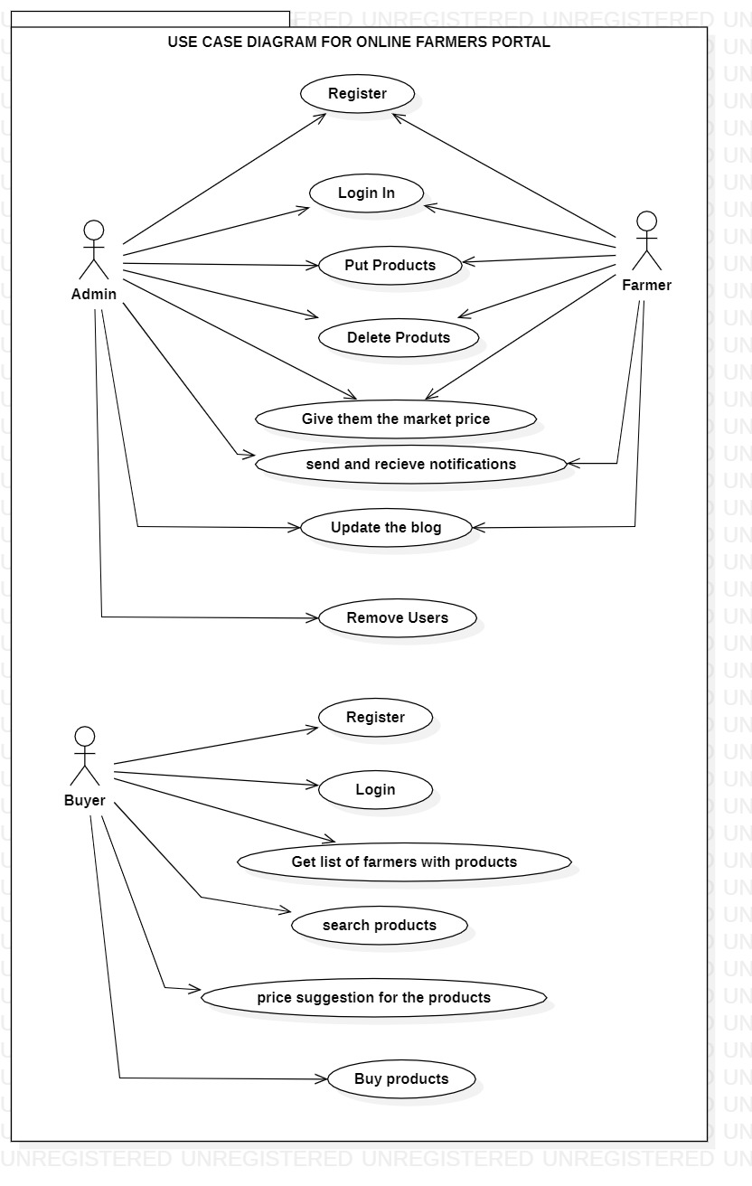
System Design :-
Use Case Diagram

Slide 13
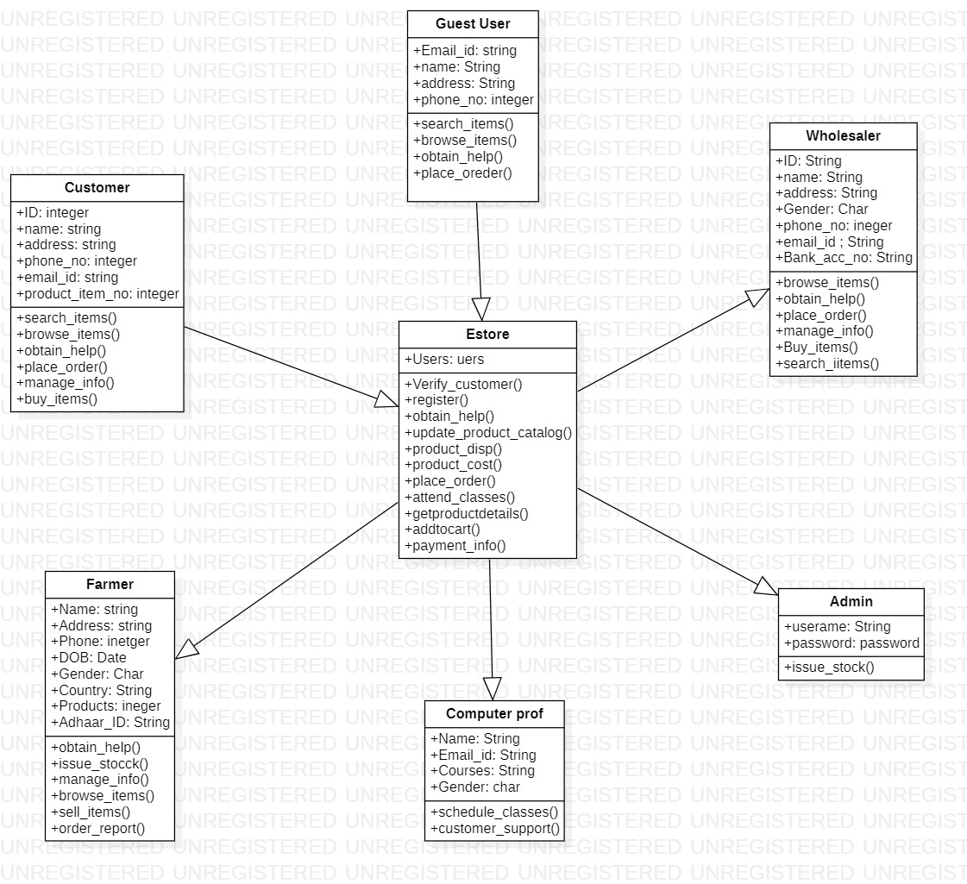
Class Diagram

Slide 14
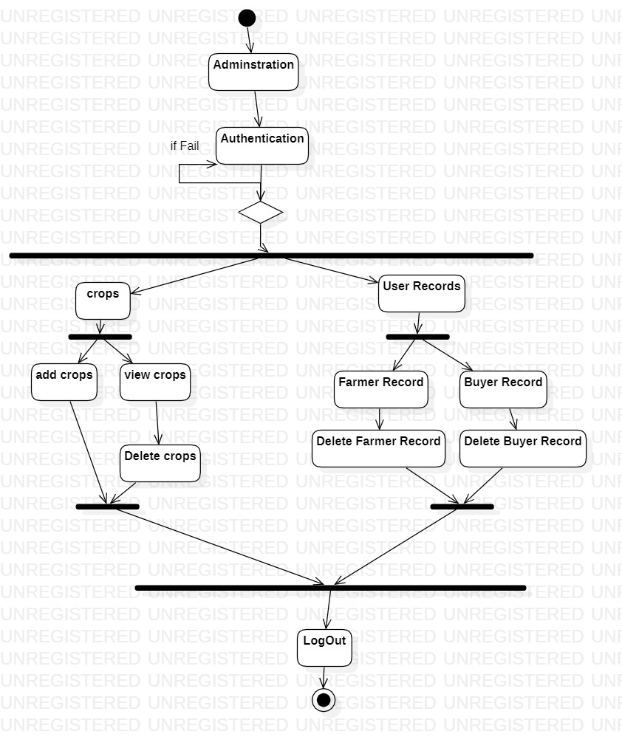
Activity Diagram for Admin

Slide 15
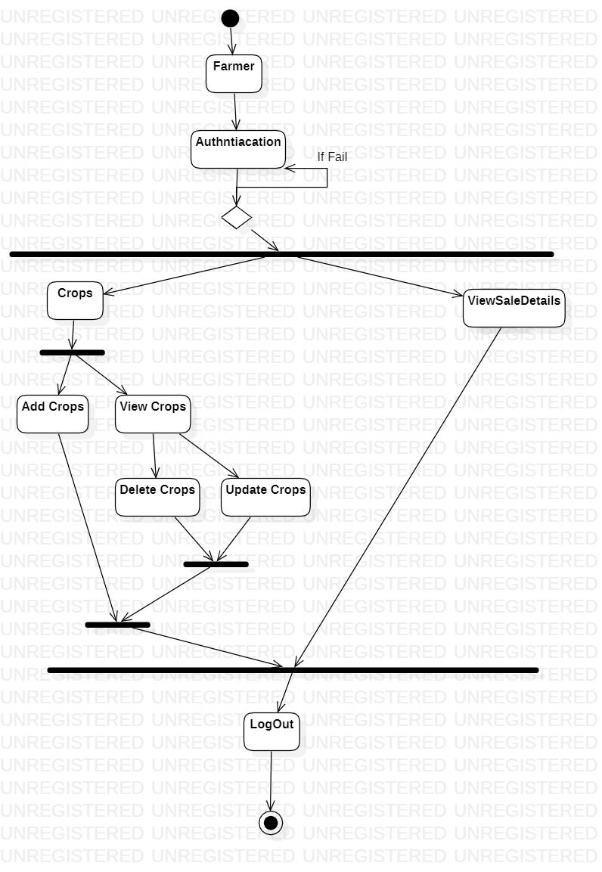
Activity Diagram for Farmers

Slide 16
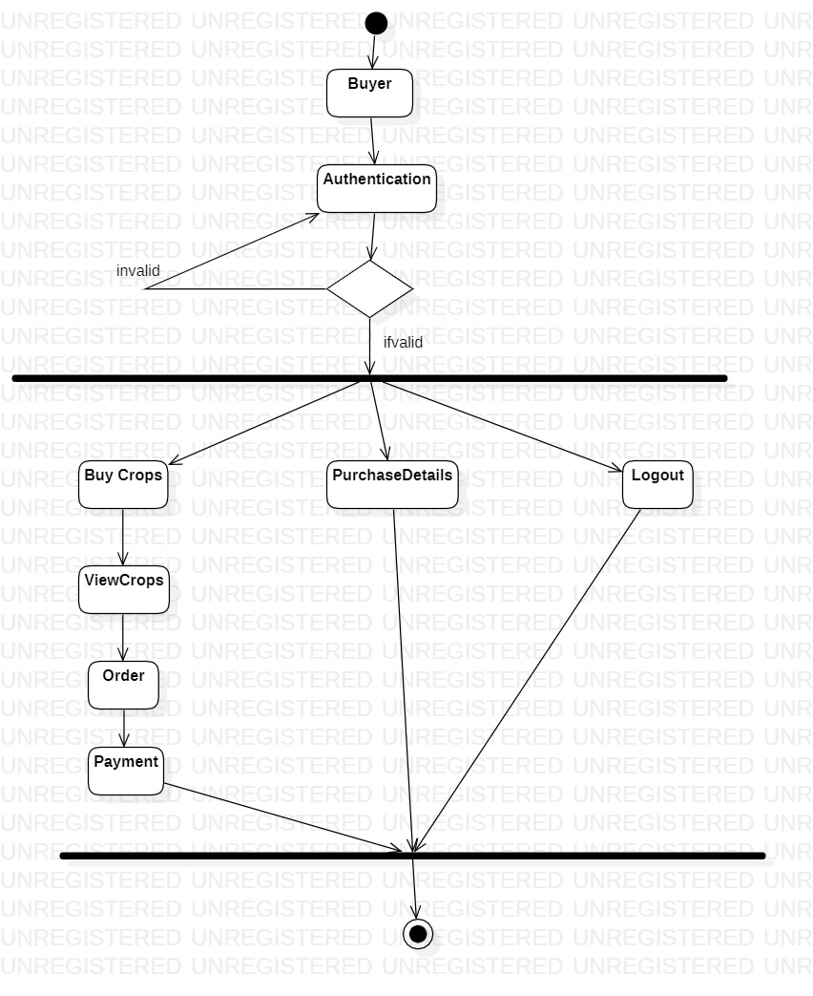
Activity Diagram For Buyer

Slide 17
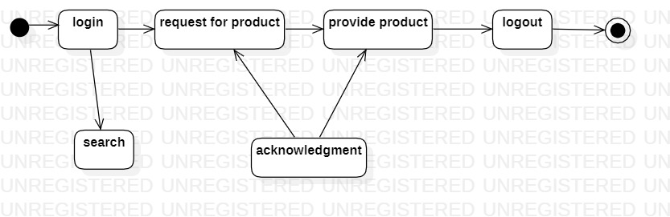
State chart Diagram

Slide 18
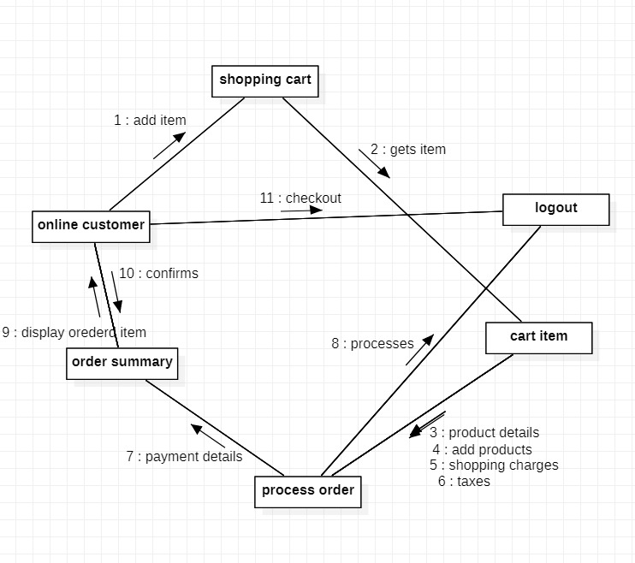
Collaboration Diagram

Slide 19
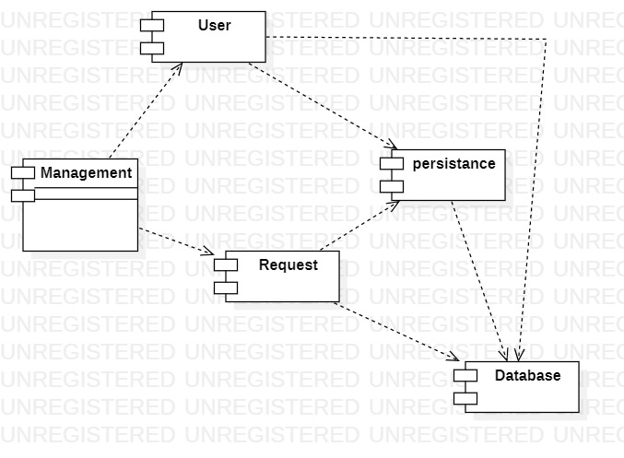
Component Diagram

Slide 20
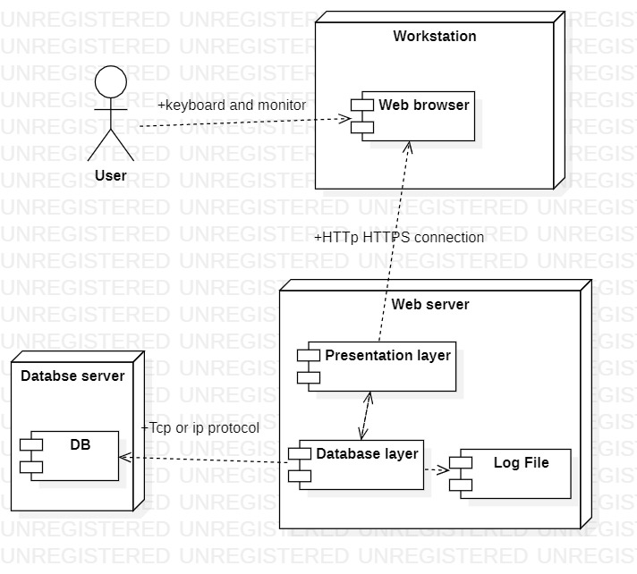
Deployment Diagram

Slide 21
Software Requirements
Operating System : - Windows 10/ Linux
User Interface : - HTML,CSS
Client-side Scripting : - Javascript
Programming Language : - PHP
IDE/Workspace : - Visual studio code
Database :- Mysql / oracle
Web Server :- Xampp

Slide 22
Hardware Requirements
Processor : pentium 4
Hard Disk : 40GB
RAM : 2GB

Slide 23
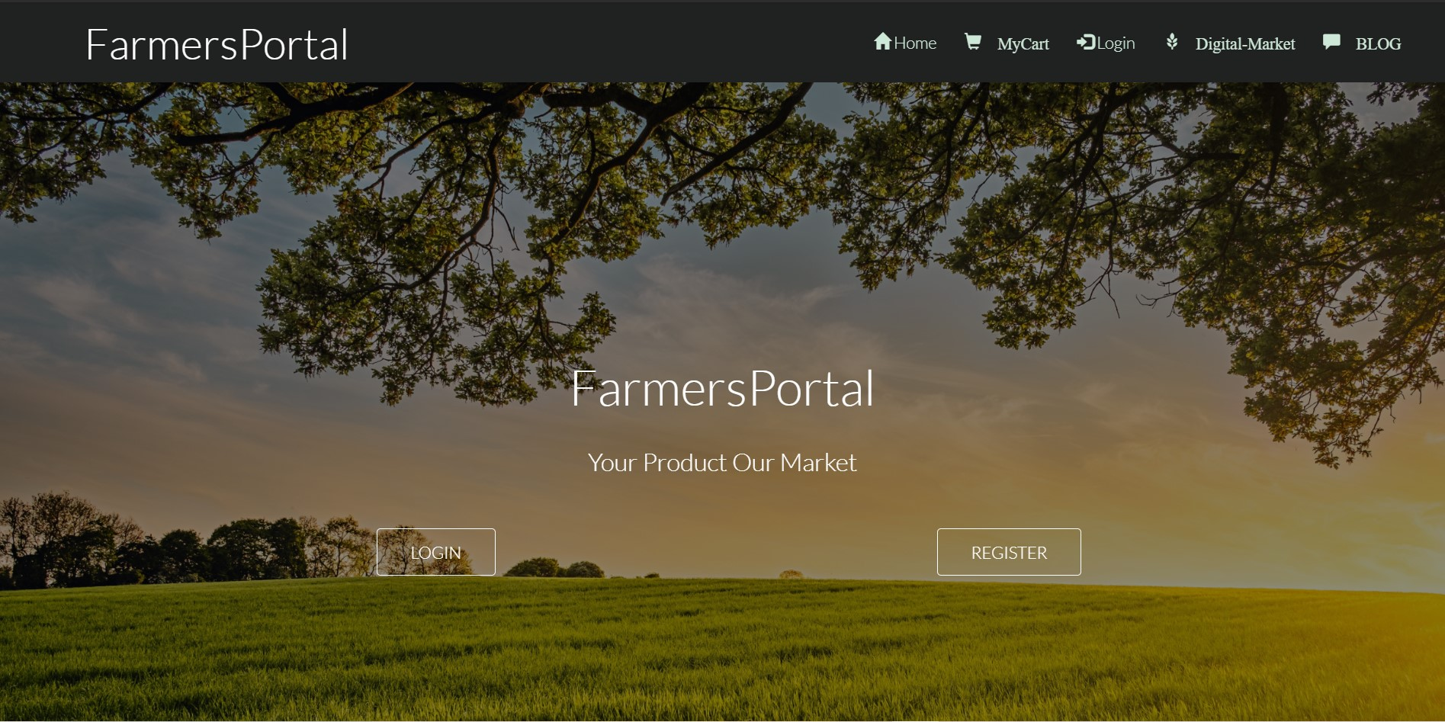
OUTPUT SCREENS

Slide 24
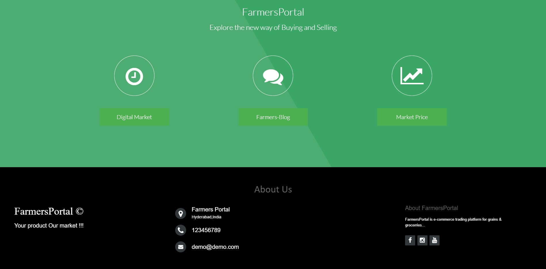

Slide 25
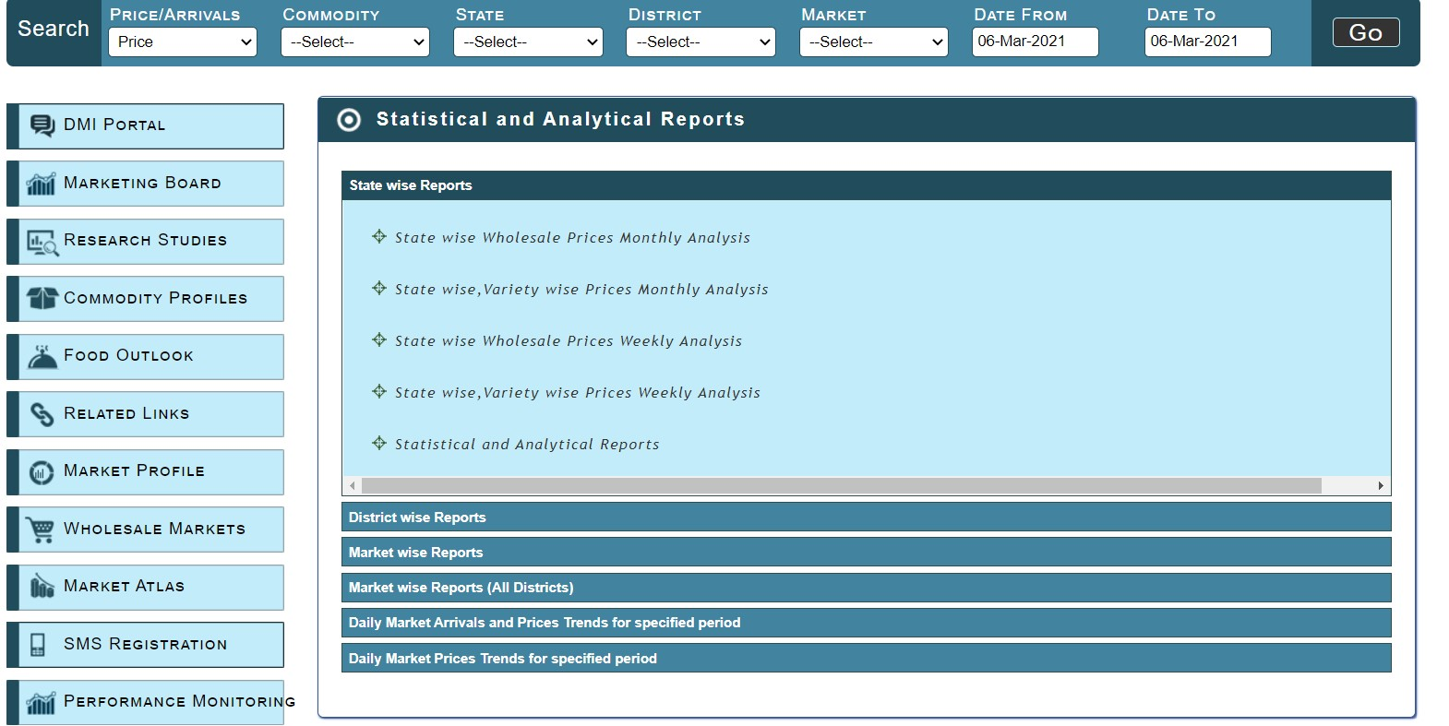

Slide 26
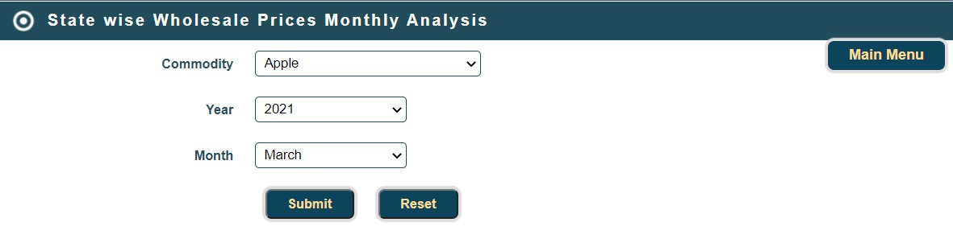

Slide 27
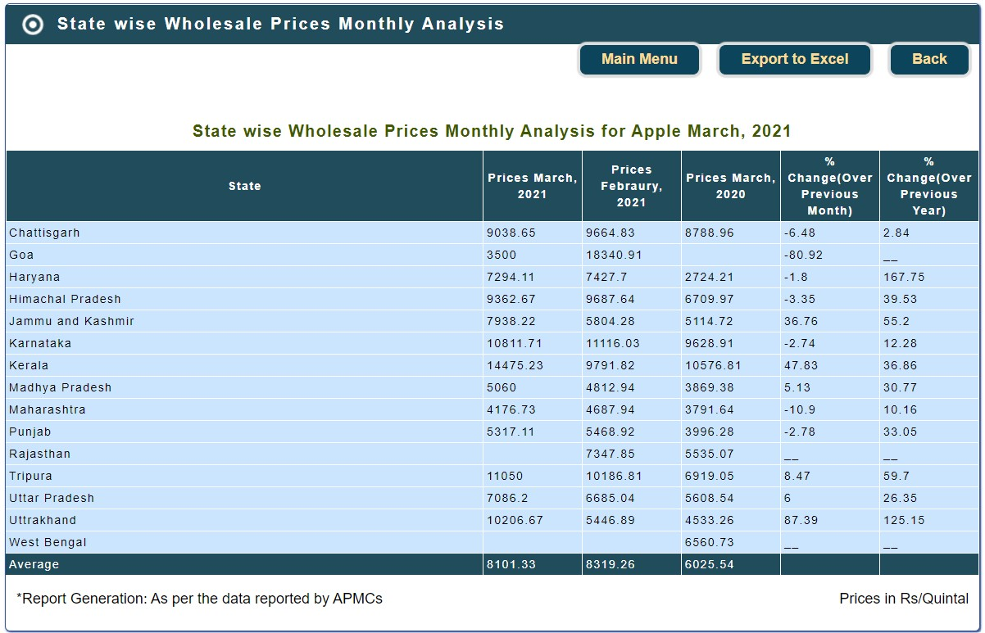

Slide 28
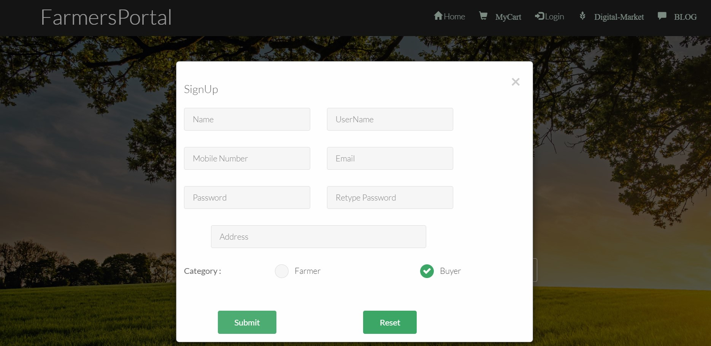

Slide 29
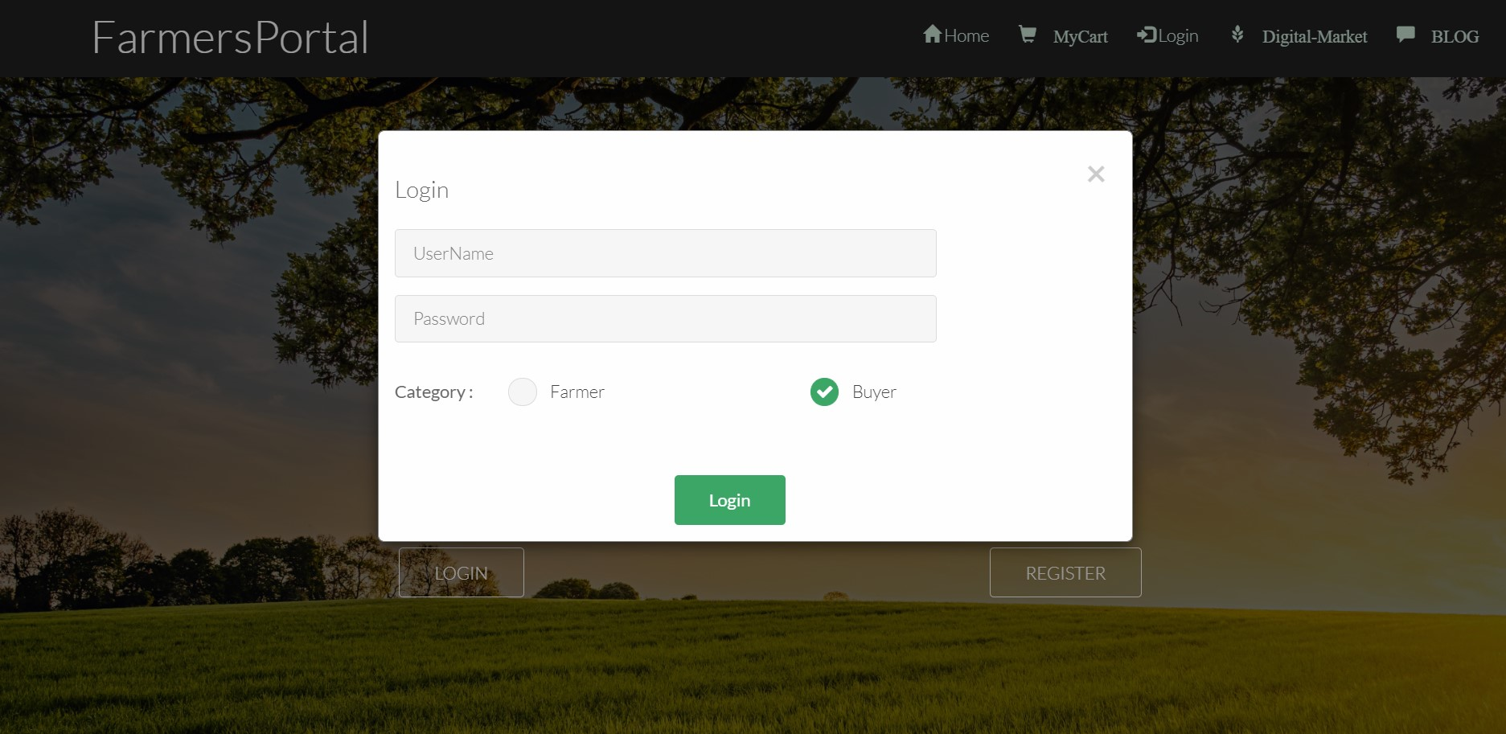

Slide 30
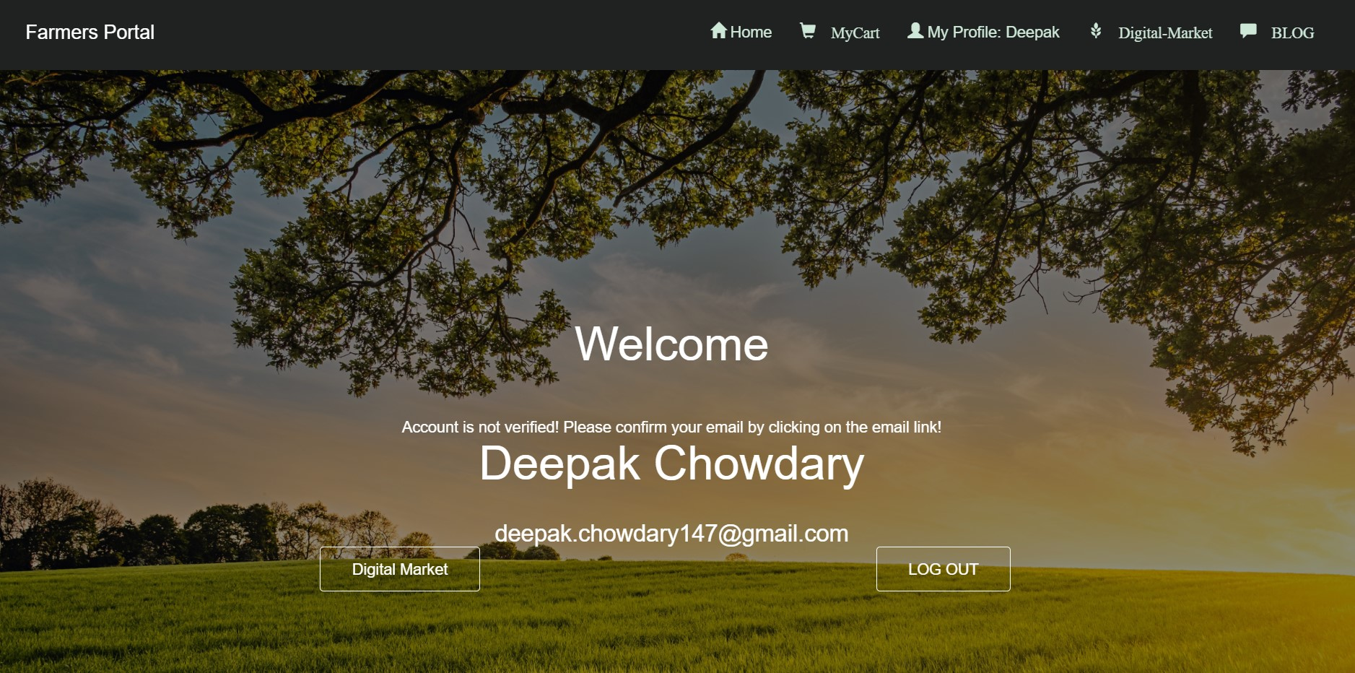

Slide 31
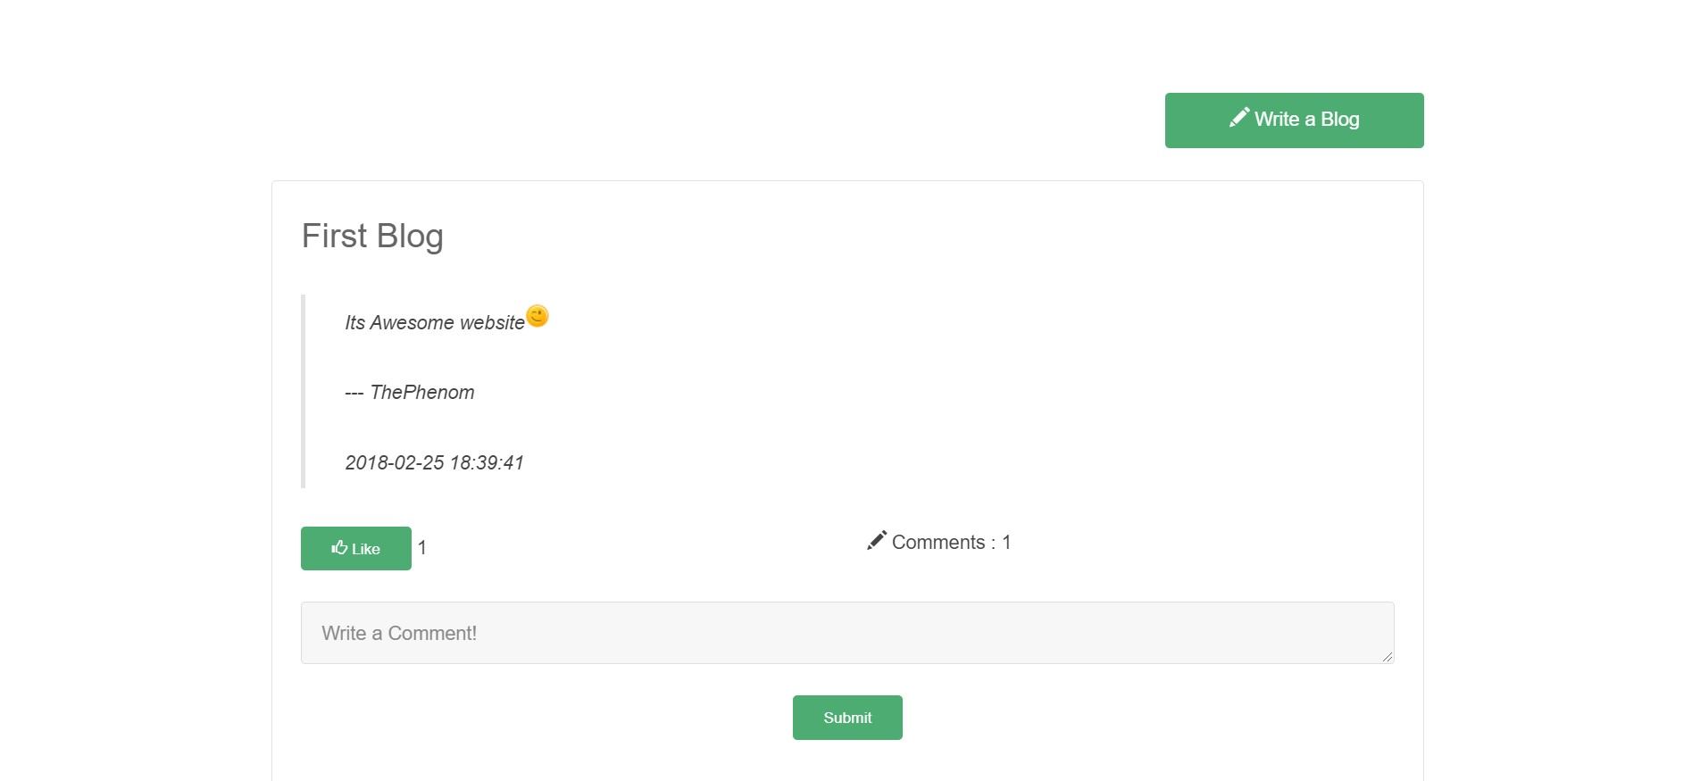

Slide 32
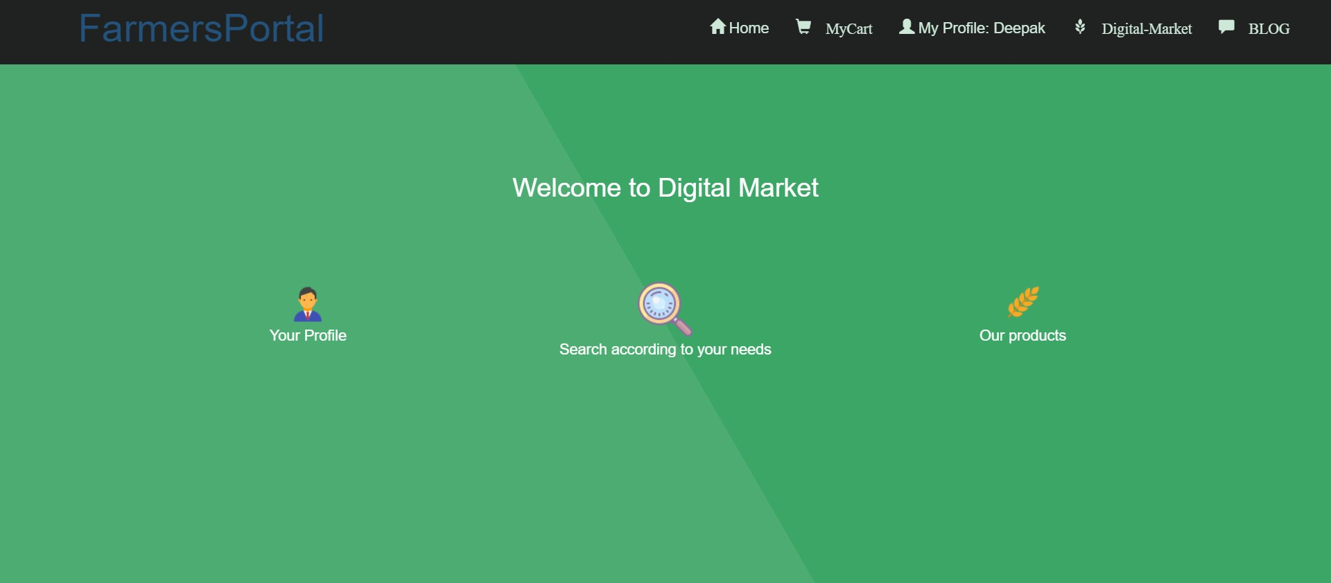

Slide 33
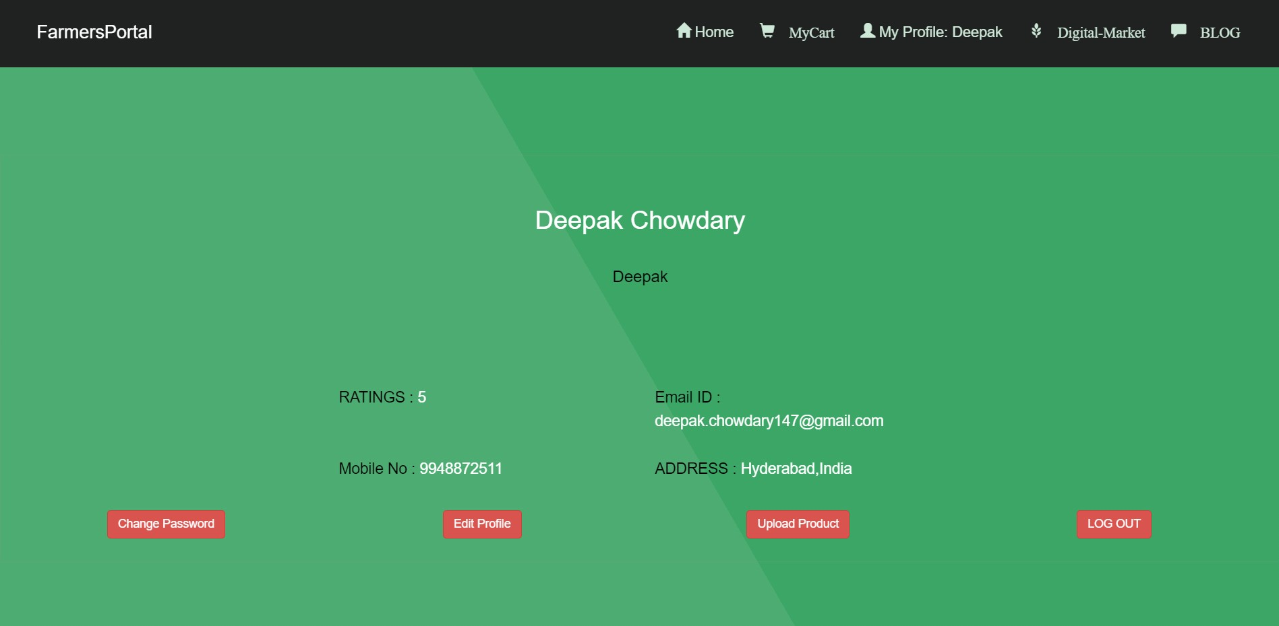

Slide 34
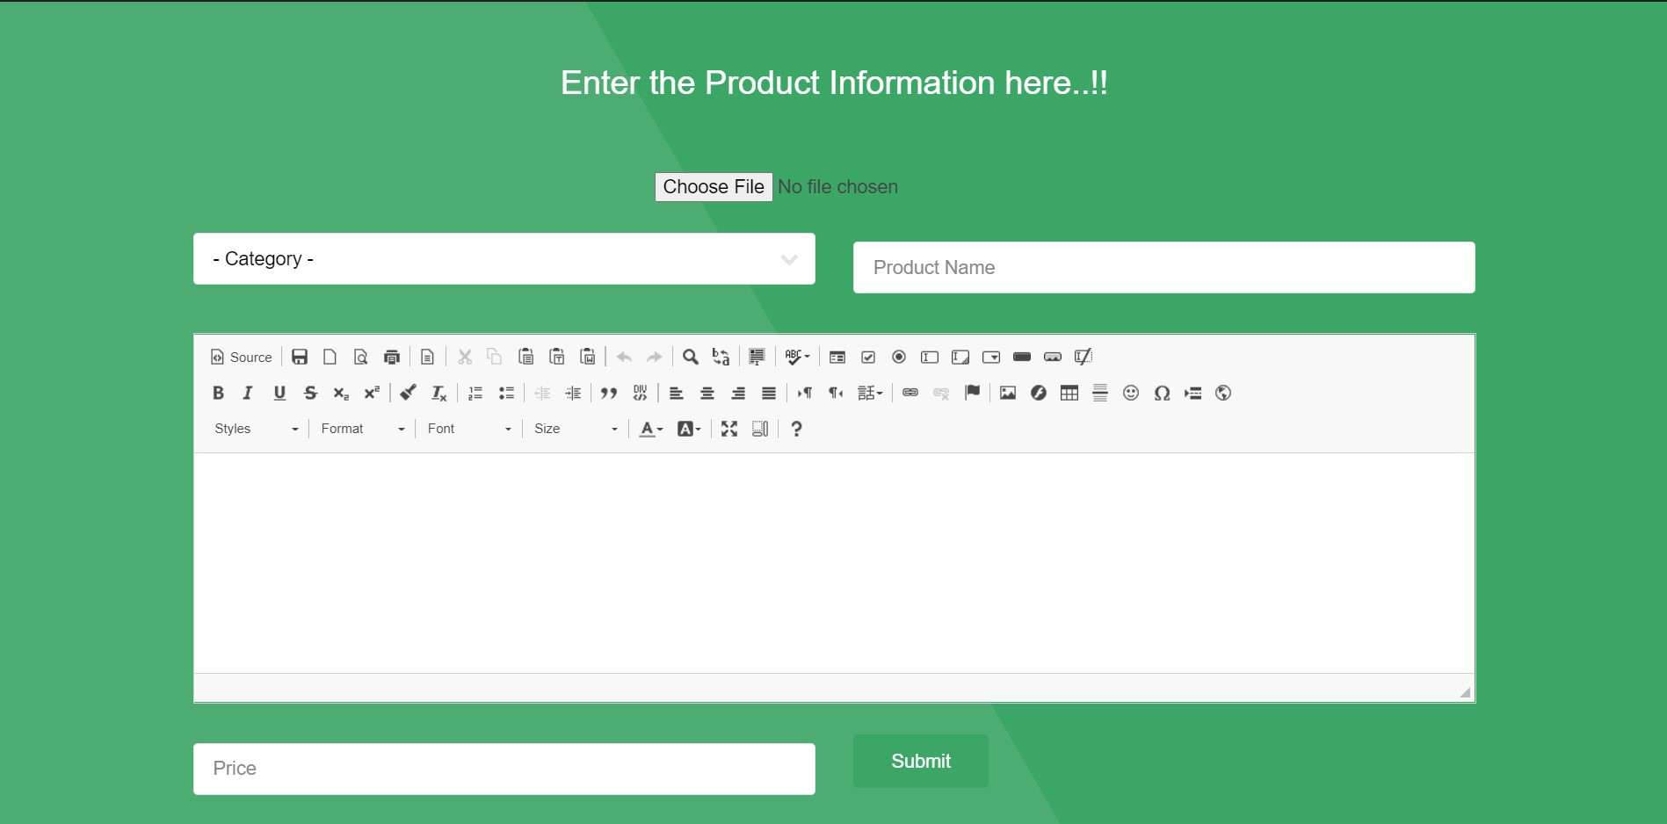

Slide 35
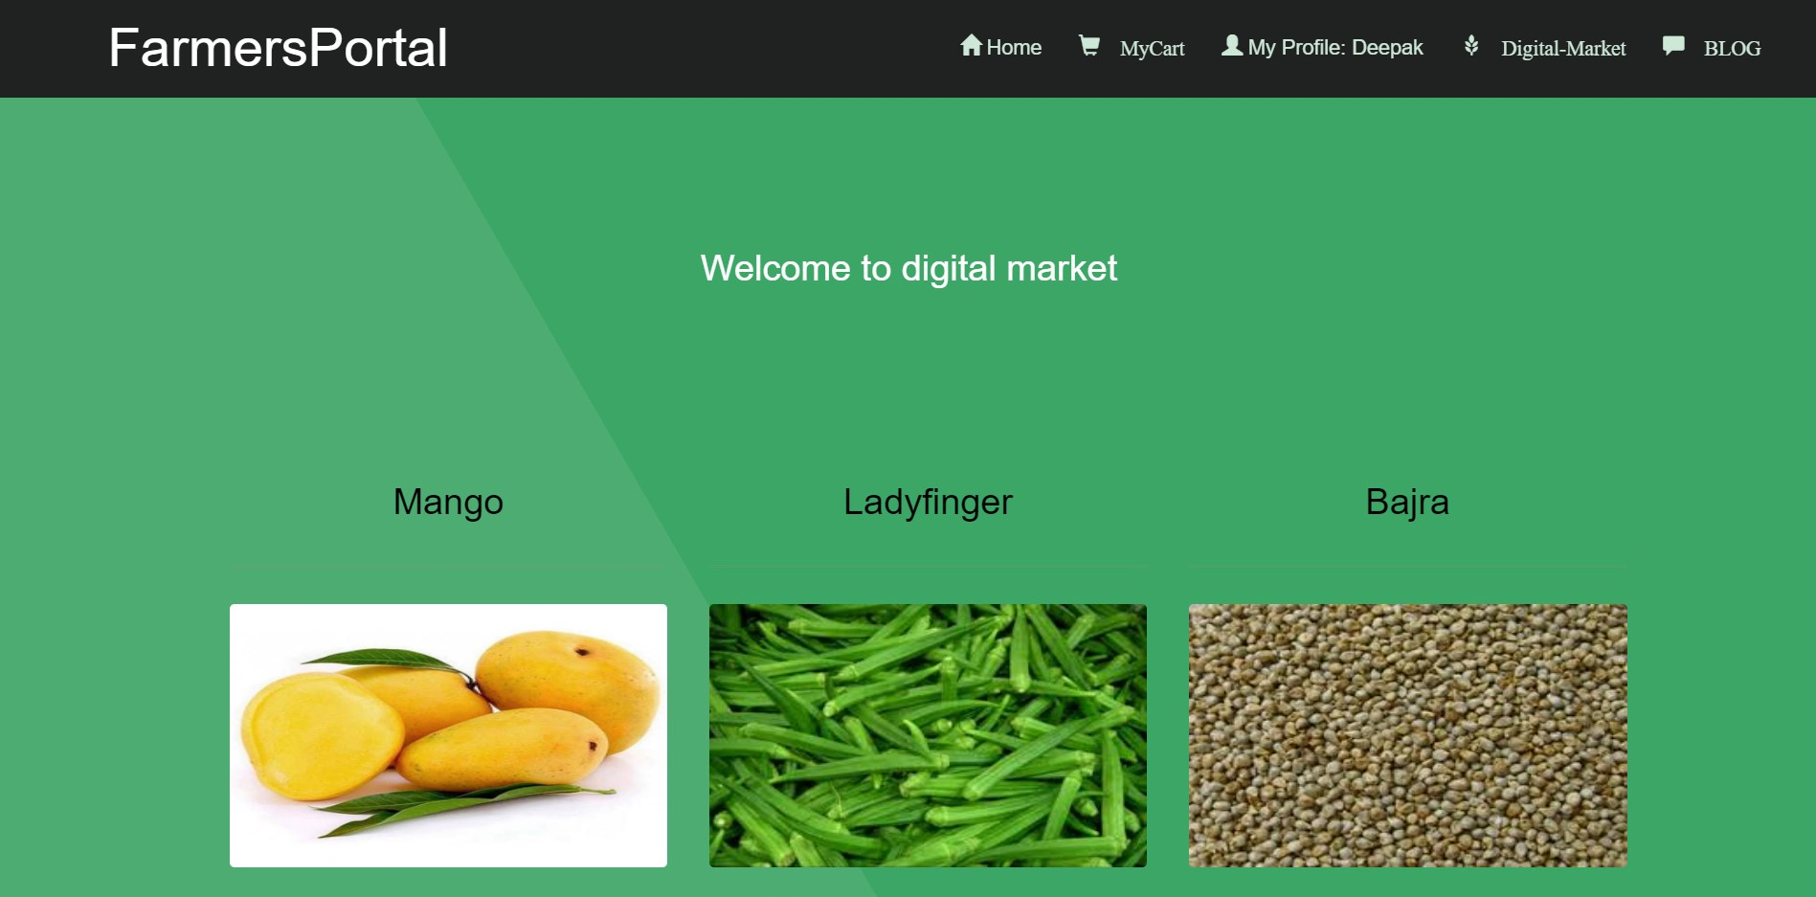

Slide 36
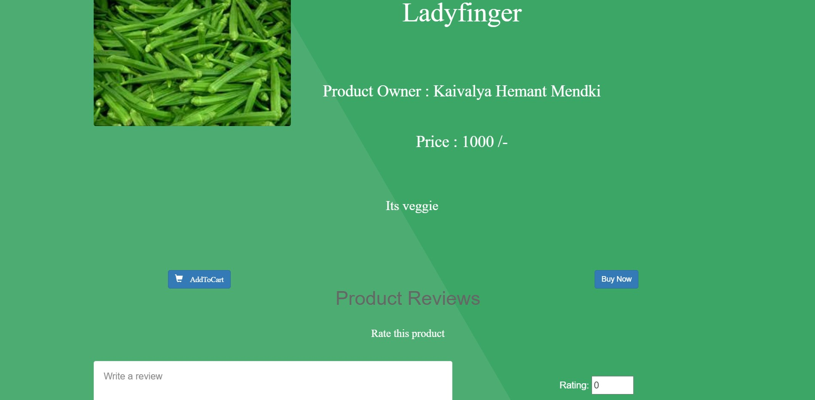

Slide 37
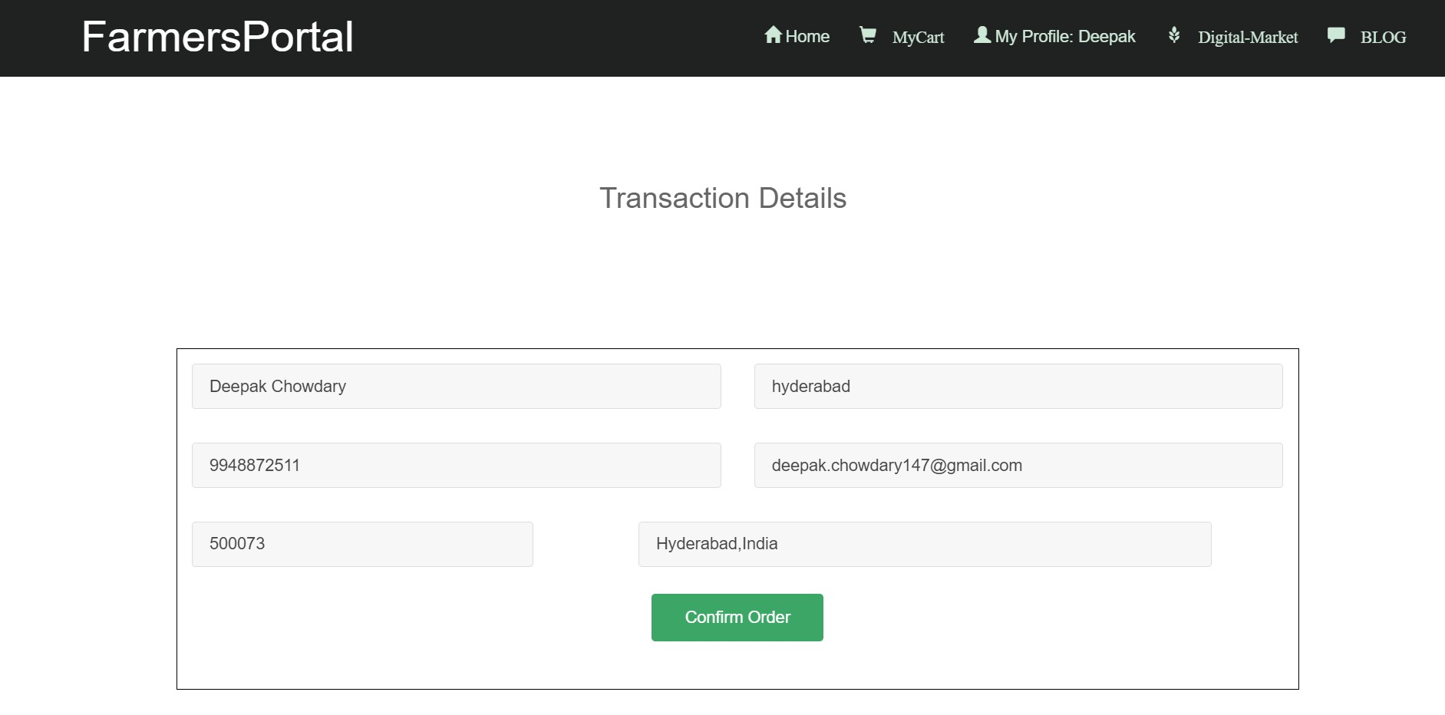

Slide 38
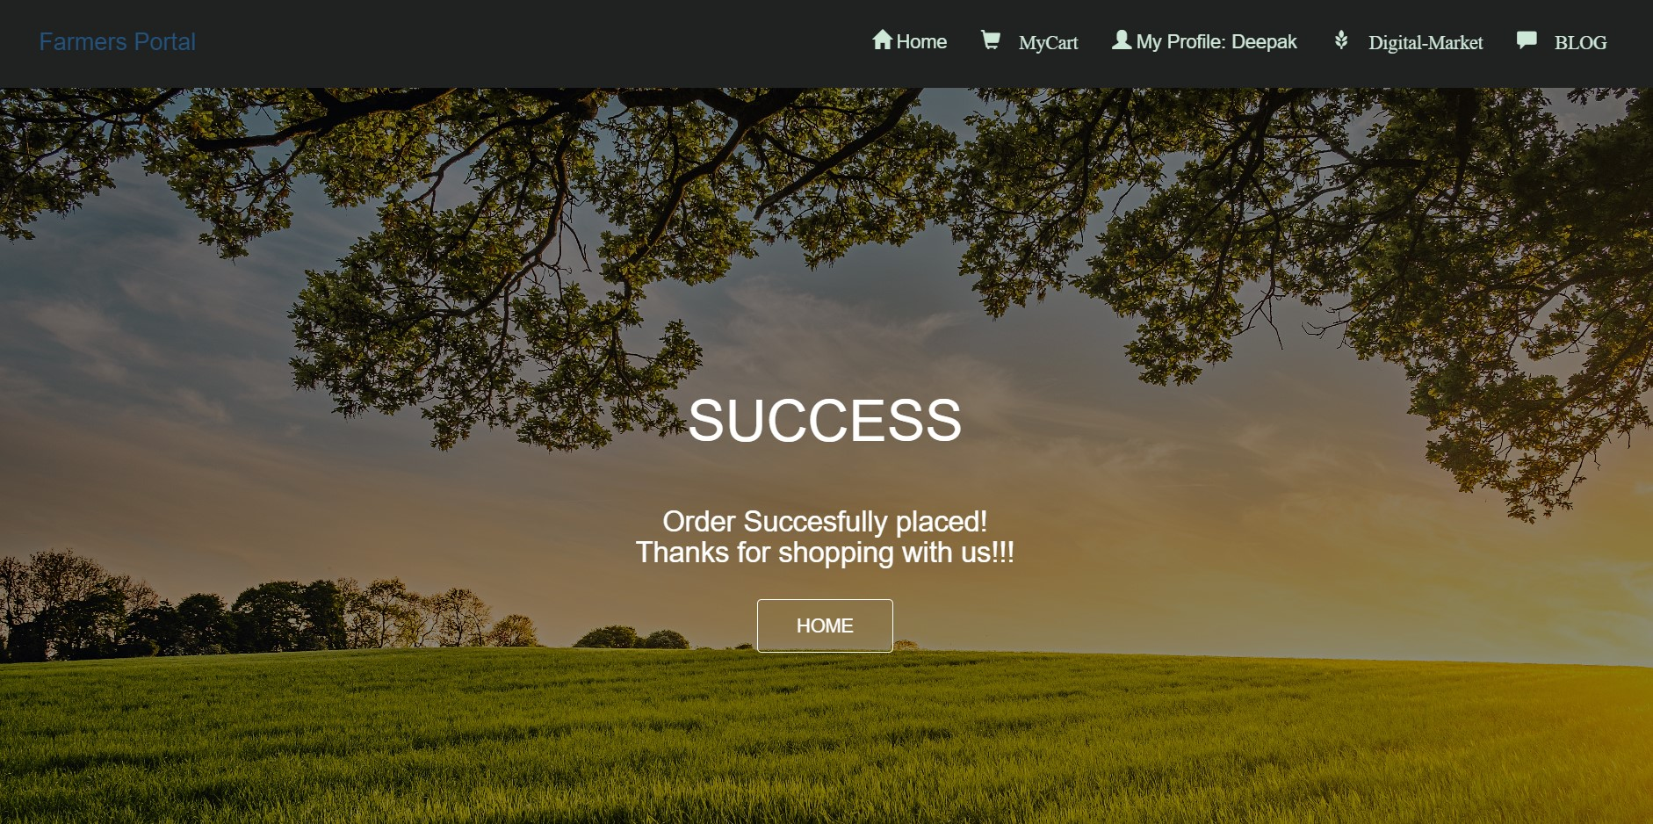

Slide 39
Future work
Need To Develop the website to be more user friendly
Add a chat box for customer support
To introduce more products
To educate farmers about online selling
Order Tracking and Online Transactions will be introduced soon

Slide 40
Conclusion :-
Our project has been successfully implemented the idea of online business.
Buyers and sellers can purchase anything from anywhere. Our project helps
buyers and sellers in saving a lot of time and money.

Slide 41
Thank You ………

